Slide 1



Project Title: Women safety wearable device using IOT
JEPPIAAR INSTITUTE OF TECHNOLOGY
“Self-Belief | Self Discipline | Self Respect”
Department Of Electronics and Communication Engineering
Team Members:
Students Name Reg.No:
1.Adhiyamaan NS 210620106002
2.Gugan R 210620106021
3.Gokulnath V 210620106019
Internal Guide: External Guide: (If Any)
Dr. Kumutha

Slide 2
Abstract
This project aims the development of devices and systems that leverage the connectivity and data processing capabilities of IoT to enhance the safety of women in various scenarios. Women’s safety is a pressing concern in today’s society and the advancement of IoT technology offers a promising solution. The project is to design a system to detect potential threats, alert emergency services, provide real-time tracking , measures blood pressure and temperature for loved ones. It employs IoT sensors for environmental monitoring and wearable devices for individual tracking. A secure cloud infrastructure collects, stores and processes data, emphasizing data integrity and security. Machine learning algorithms analyze the data, identifying potential safety risks and detecting unusual patterns. The device features a versatile alert system communicating through SMS or email, ensuring swift responses in emergencies. The system is designed for scalability, integrating with existing safety structures, and undergoes rigorous testing for reliability. The wearable device offers a holistic safety solution and the integration of machine learning ensures proactive threat detection. A user-friendly interface enables easy monitoring and settings management. By combining IoT, cloud technology and machine learning, it aims to create a robust and adaptable safety system, fostering a safer environment for women in various scenarios.

Slide 3
Objective
The device aims to enhance personal safety through real-time monitoring and alerts for potential threats or emergencies. It's designed to be easily accessible and user-friendly, allowing individuals to carry it at all times without hassle.
Prioritizing data security and privacy, encryption and secure data transmission protocols are implemented to protect user information. Seamless integration with existing safety and emergency response systems enables quick and effective responses.
Community and user engagement are vital, with feedback and testing essential for refining functionality and usability. Additionally, the project aims to raise awareness about safety issues and promote the adoption of technology-based solutions.
In summary, the objective is to create a device that enhances personal safety, improves accessibility, ensures data security, integrates with existing systems, engages with the community, and promotes awareness and education about safety.

Slide 4
Motivation/ Problem Statement
The women's safety wearable sensor project using IoT technology is driven by the urgent need to address rising instances of harassment and assault. It aims to empower women and ensure their safety globally. Key motivations include combating abuse, providing a tool for fearlessness, and innovating in safety solutions.
Leveraging IoT technology, the project seeks to create a portable device for real-time monitoring and emergency alerts. Community engagement is crucial for raising awareness and advocating for technology-based solutions.
In essence, the project strives to address safety concerns, empower women, innovate in safety, and engage communities for women's safety and empowerment.
Domain of the Project : IOT

Slide 5
PROBLEM OF DEFINITION
Women face numerous safety concerns, including harassment, assault, and other forms of violence, which significantly impact their daily lives and overall well-being. Despite advancements in technology, there remains a gap in providing effective, accessible, and user-friendly safety solutions tailored specifically for women.
Traditional safety devices and systems often lack the ability to monitor specific conditions relevant to women's safety, such as heartbeat irregularities, which can indicate distress or danger.
Furthermore, the lack of integration with emergency services and the inability to alert immediate contacts in real-time hinders the effectiveness of existing safety measures.

Slide 6
Literature Survey
Author Name | Paper Title | Journal Name | Vol No | Issue No & Page No
Sagarika Das,Baswakiran,Jagadeesa | Women Security System | Google scholor | 7 | 1523-1529
V. Hyndavi; N. Sai Nikhita | Smart Wearable Device for Women Safety Using IoT | IEEE | 5 | 459-463
Dhruv Chand, Sunil Nayak | A mobile application for Women's Safety: WoSApp | IEEE | 10 | 1-5

Slide 7
Outcomes From Literature Survey
Paper Title | Observations (Methodology, Techniques Used, Advantages, Limitations & Result Discussion)
Womens security system | A women's security system covering all the flaws of previously designed devices is comprised of GPS and GSM modules to track the location and inform the guardian. It has a builtin hidden camera and audio recorder to help police for investigating. But the device activates the buzzer on activation, which will alert the attacker and he would snatch the device.
Smart Wearable Device for Women Safety Using IoT | Detects and sends the alerts for the dear ones with the location coordinates of the women without the requirement of her interaction in critical times. It sends an emergency message automatically to the relatives and nearby police station.
A mobile application for Women's Safety: WoSApp | women with a reliable way to place an emergency call to the police. The user can easily and discreetly trigger the calling function by shaking her phone, or by explicitly interacting with the user interface of the application via a simple press of a PANIC button on the screen
Design and Implementation of Women Safety based on IoT technology | The victim has to press the trigger to activate the modules that are attached to the microcontroller. The device should be automatically operated without human interaction

Slide 8
Proposed Methodology
To propose a women's safety management system using IoT and a cloud server, several components and steps are typically considered. These include the utilization of a range of IoT sensors and devices such as GSM, and heart rate monitors to monitor both the environment and individual status.
Additionally, establishing a cloud server is essential to collect, store, and process data from these devices, ensuring data integrity, security, and accessibility. Implementing machine learning algorithms aids in analyzing collected data, predicting safety risks, and detecting unusual patterns.
Developing an alert and notification system is crucial to send alerts via SMS, push notifications in case of safety threats. Creating a user-friendly interface enables users to monitor safety status, control IoT devices, and manage safety settings.
Scalability, easy maintenance, and updates are vital design considerations for accommodating growing user numbers.
Integration with existing safety systems like emergency response services ensures a comprehensive safety solution. Thorough testing and validation are conducted to ensure reliable system functionality, with user training and support provided to ensure effective system utilization and response to safety alerts.

Slide 9
Hardware Requirements
Pulse sensor
Node MCU
Button
Led display
Mini GSM
GPS module
Temperature sensor

Slide 10
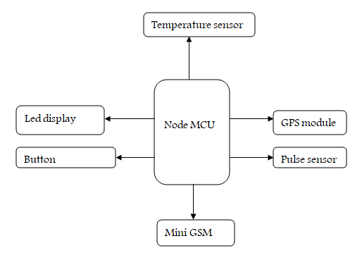
Block Diagram

Slide 11
Major Components/ Algorithm Used
1. GPS (Global Positioning System):
GPS is a satellite-based navigation system that provides location and time information anywhere on Earth.
In an embedded system, a GPS module receives signals from satellites to determine the device's precise geographical coordinates.
GPS modules are commonly used in applications such as vehicle tracking, navigation systems, and location-based services.

Slide 12
Result & Discussion
Outputs/ Comparison Graphs
IoT-based wearable safety devices for women represent a significant step forward in addressing the issue of women's safety.
By leveraging sensor technology, connectivity options, and embedded algorithms, these devices offer a promising solution to personal safety challenges. However, ongoing research and development are necessary to address potential limitations and to ensure that these technologies are accessible and effective for all users.

Slide 13
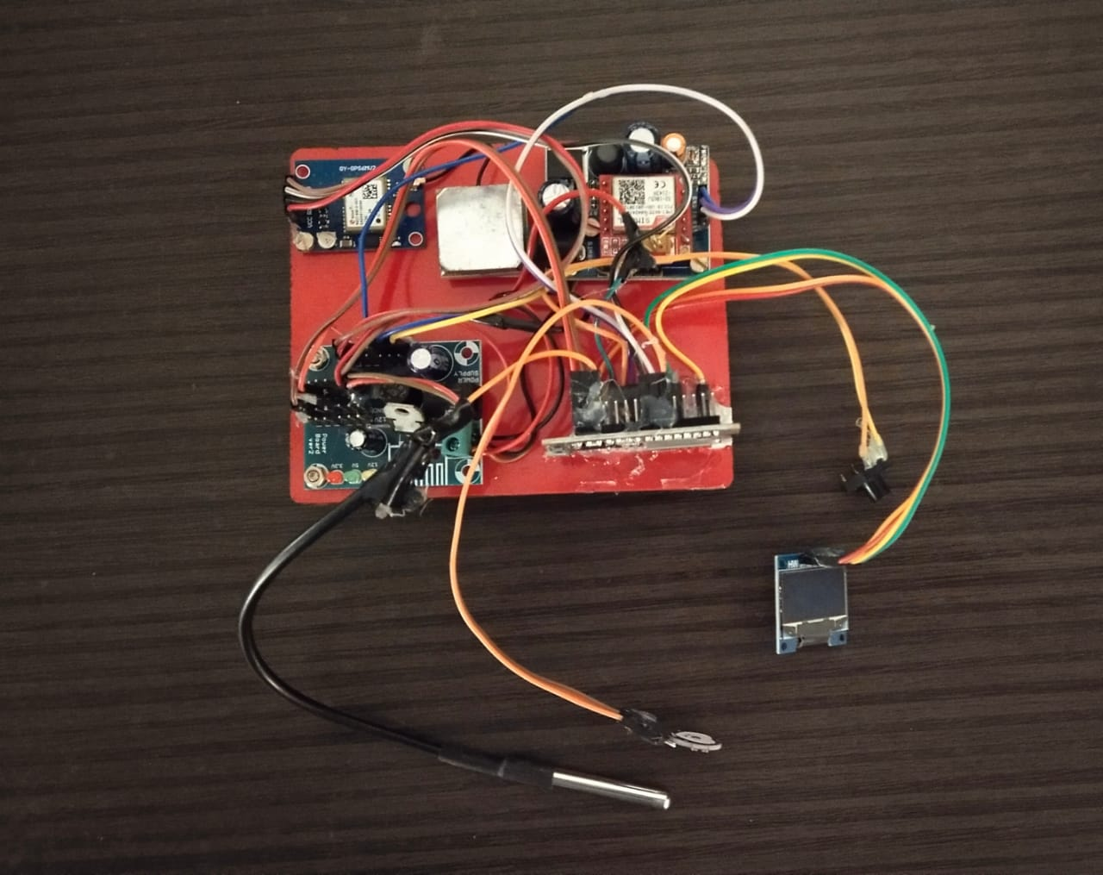
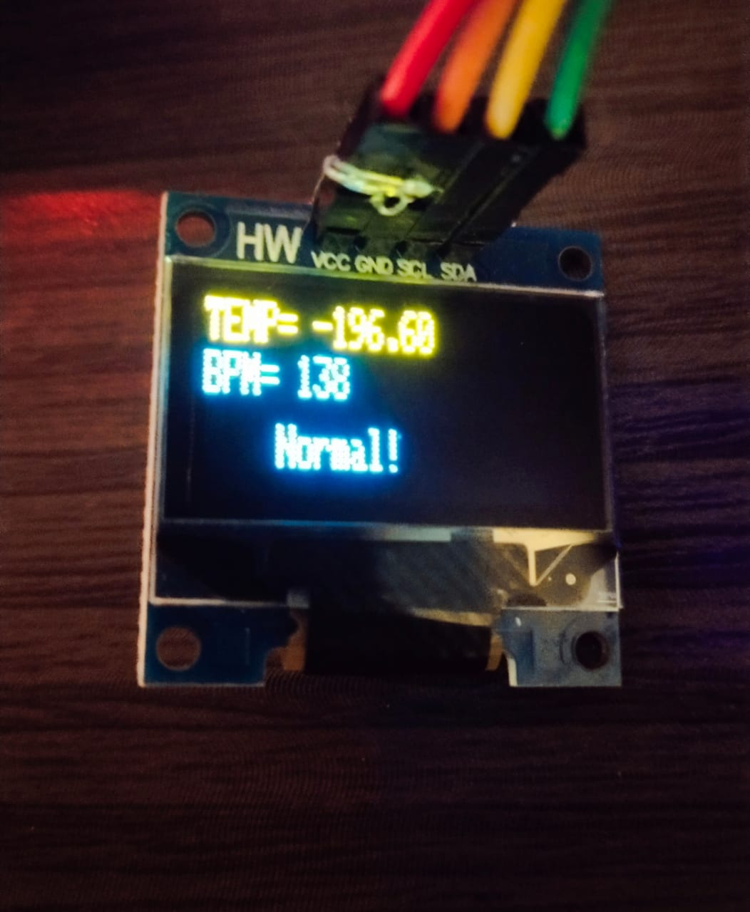
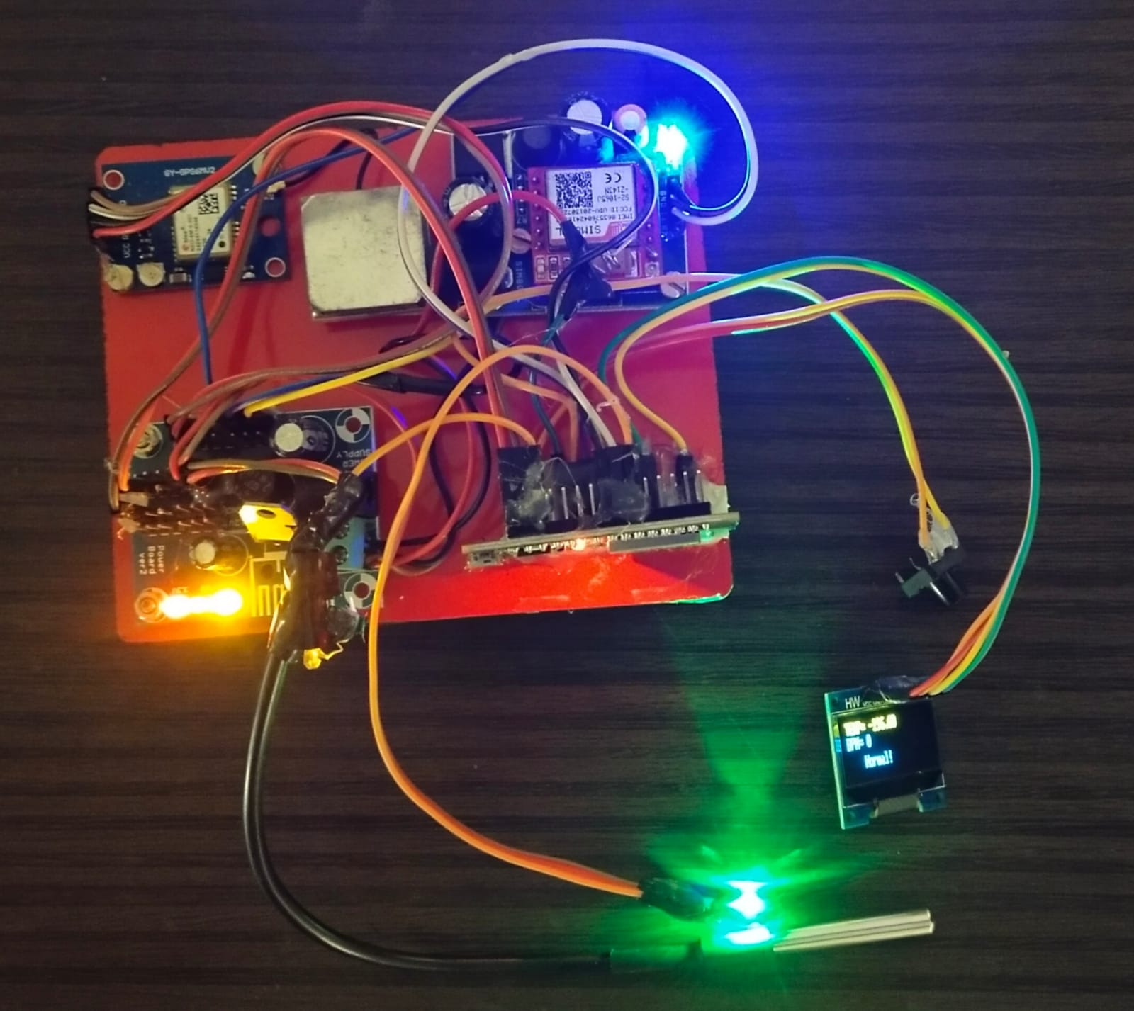

Slide 14
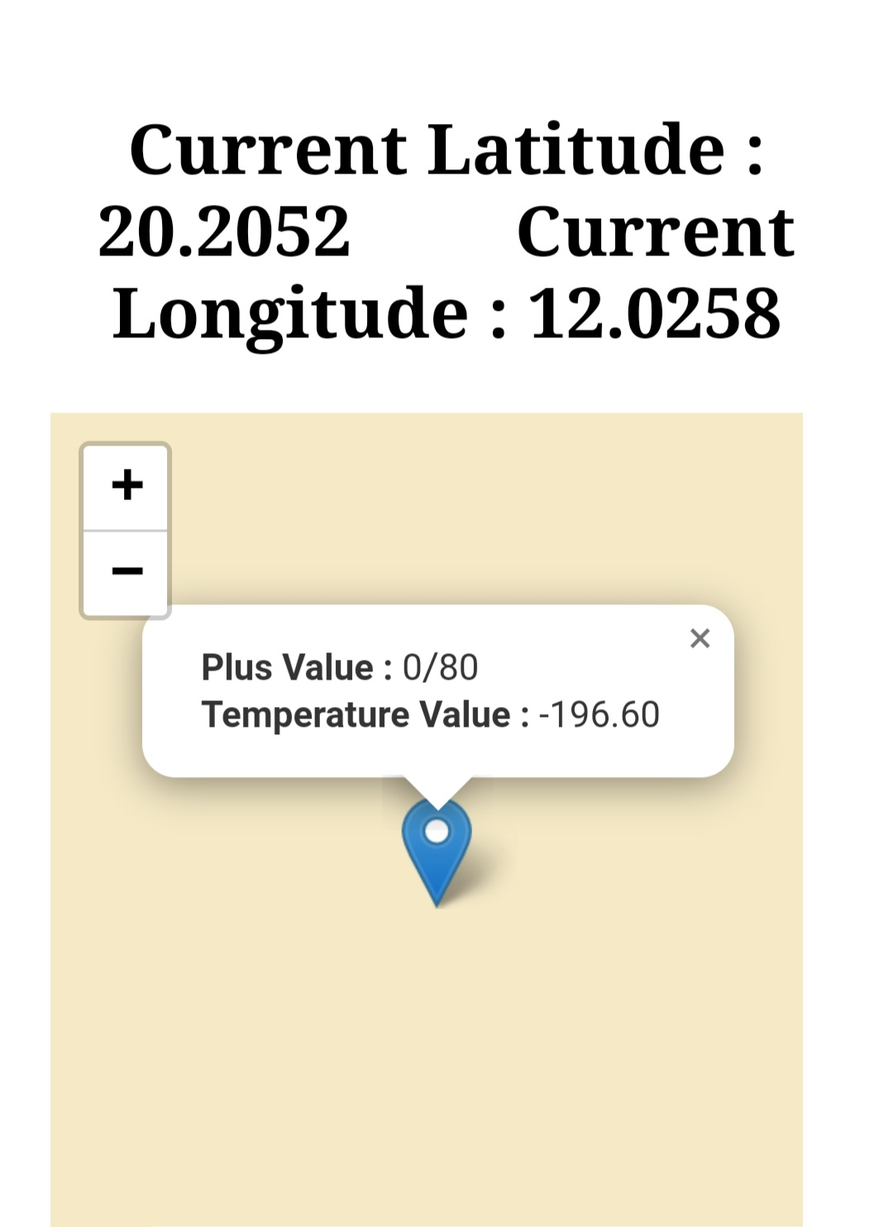
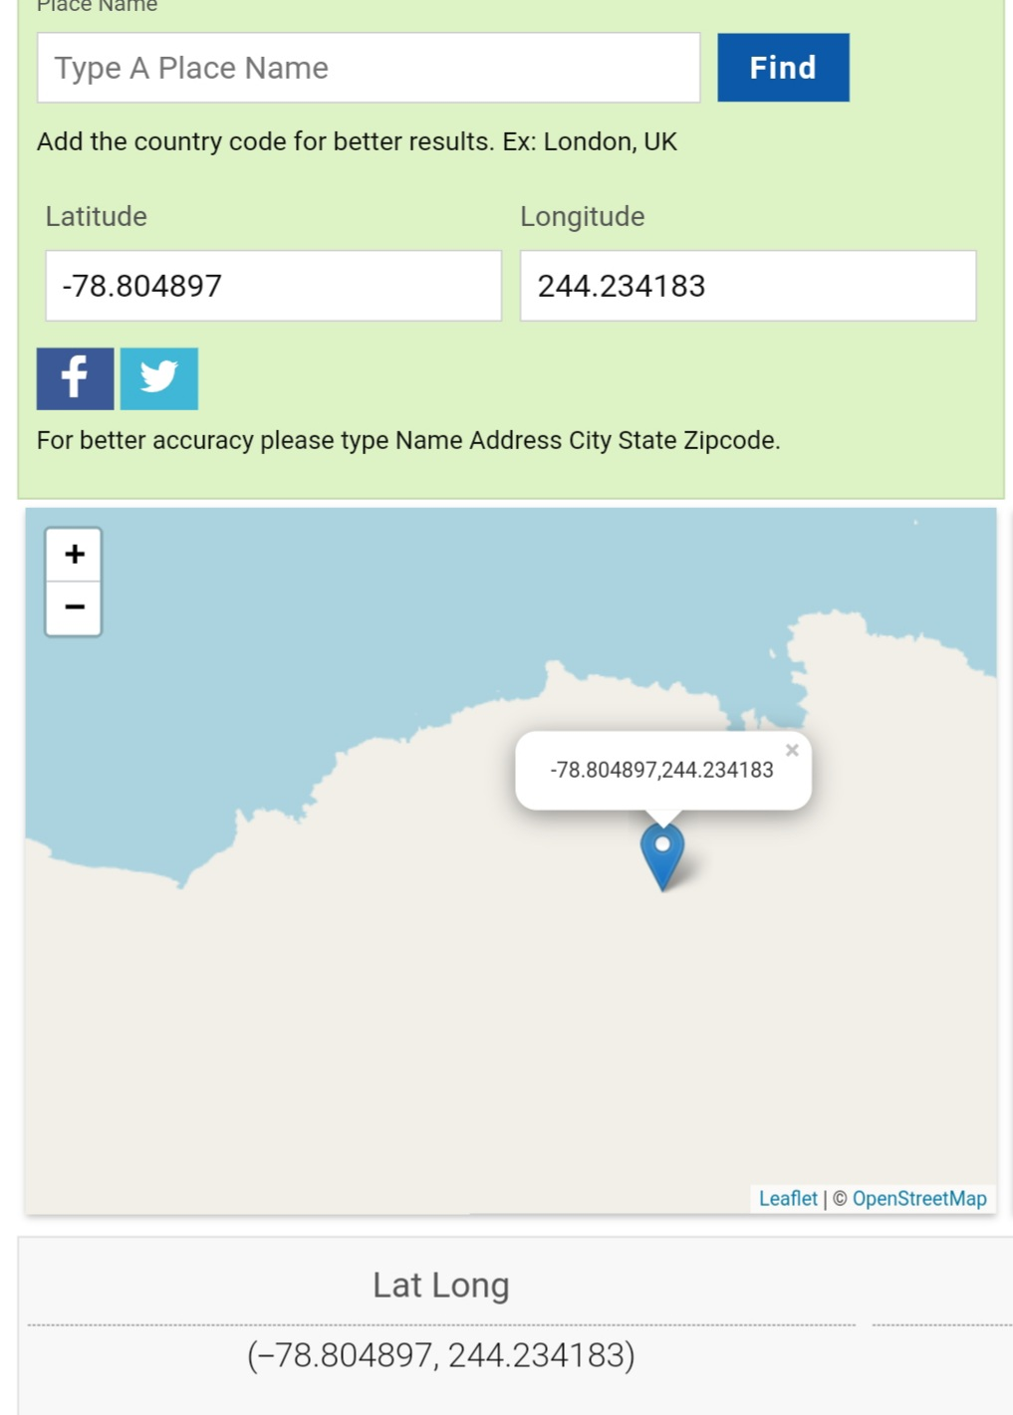

Slide 15
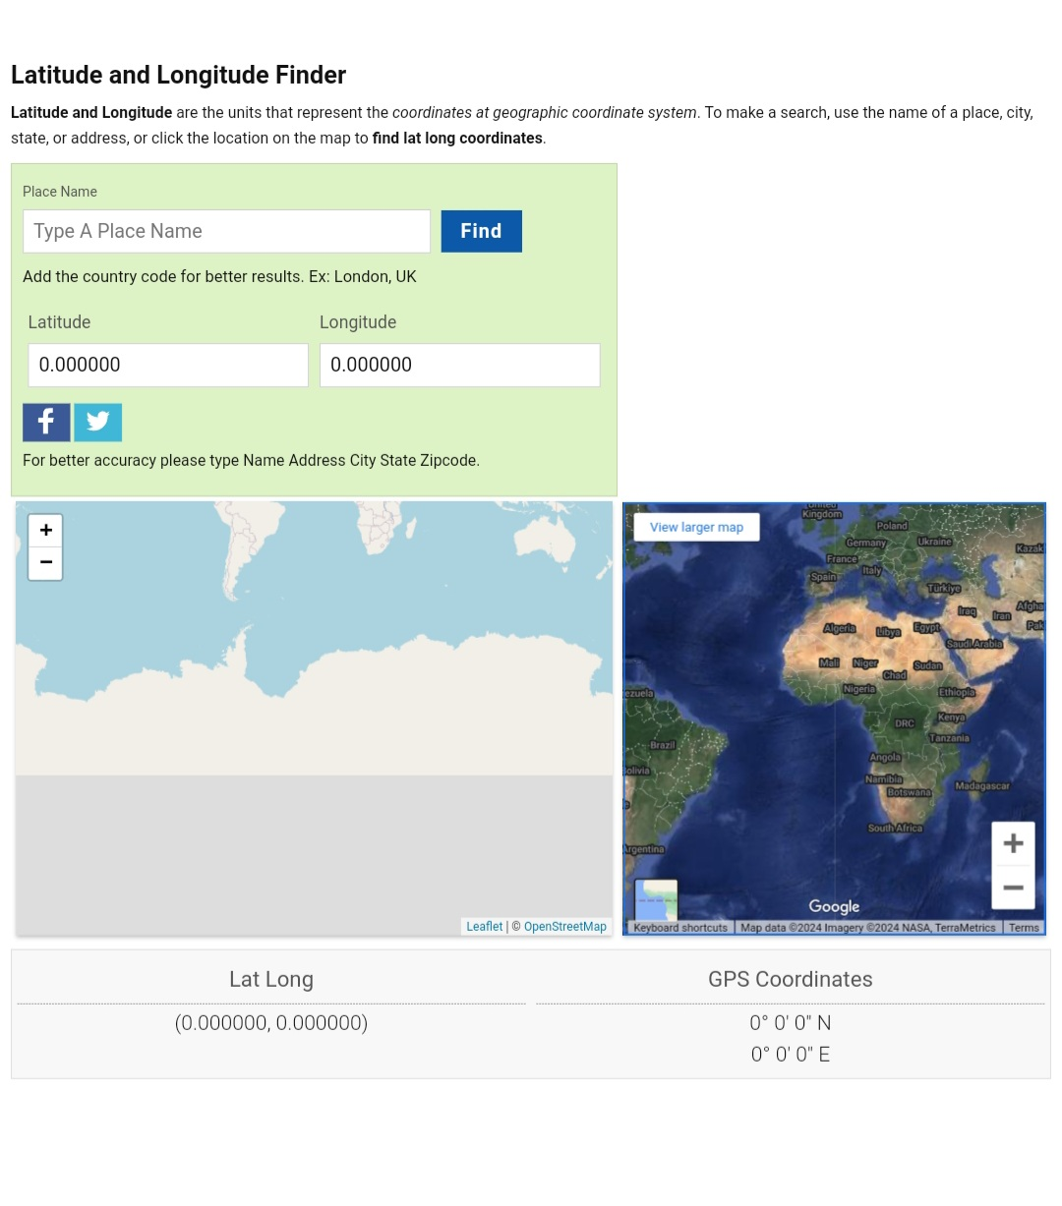

Slide 16
Future Scope
Future enhancements could focus on developing more sophisticated machine learning algorithms capable of detecting a broader range of threats and predicting dangers more accurately.
Strengthening integration with smart home systems could provide additional layers of safety. Enhancing battery life and durability is vital for ensuring prolonged use, and improvements in user interface and experience could enhance usability and effectiveness..

Slide 17
Conclusion
Wearable safety devices for women, employing IoT and machine learning technologies, have emerged as effective tools in enhancing personal safety. These devices leverage IoT connectivity to connect wearable sensors to the internet, allowing real-time monitoring and alerting. They detect abnormal behavior or conditions that may indicate potential threats, providing discreet and non-intrusive safety monitoring. Integration with machine learning enables continuous monitoring and immediate responses to dangers. Future improvements could focus on developing more advanced machine learning algorithms, enhancing integration with smart home systems, improving battery life and durability, and refining user interface and experience. Overall, these devices offer promising prospects for enhancing women's safety, with potential for further enhancements to solidify their role as invaluable safety tools.

Slide 18
Publications
National Conference
International Conference
National Journal
International Journal

Slide 19
Reference
[1] Suraksha. A device to help women in distress: An initiative by a student of ITM University Gurgaon.efytimes.com. 2013. Available from: http://efytimes.com/e1/118387/SURAKSHAA-Device-To-Help-Women-In-Distress-An-Initiative-By-AStudent-Of-ITM-University-Gurgaon.pdf
[2] Pantelopoulos A, Bourbakis NG. A survey on wearable sensor-based systems for health monitoring and prognosis. IEEE Transactions on Systems, Man and Cybernetics – part C: Applications and Reviews. 2010 Jan; 40(1):1–12.
[3] Toney G, Jaban F, Puneeth S. et al. Design and implementation of safety arm band for women and children using ARM7. 2015 International Conference on Power and Advanced Control Engineering (ICPACE); Bangalore. 2015 Aug 12-14. p. 300–3.
[4] Vigneshwari S, Aramudhan M. Social information retrieval based on semantic annotation and hashing upon the multiple ontologies. Indian Journal of Science and Technology.2015 Jan; 8(2):103–7.
[5] Chand D, Nayak S, Bhat KS, Parikh S. A mobile application for Women’s Safety: WoS App. 2015 IEEE Region 10 Conference TENCON; Macao. 2015 Nov 1-4. p. 1–5.

Slide 20
Thank You

